Slide 1


User Manual
How to set up Browser Stack For Visual Testing
May 2021

Slide 2

Introduction
As part of the cross-browsers testing strategy for Mobius 2.0, we will be using the tool Browser Stack for visual cross-browsers testing. This slide-deck serves as a step-by-step manual on how to set up Browser Stack To find out more about the testing strategy and the list of browsers supported by Mobius 2.0 click here

Slide 3
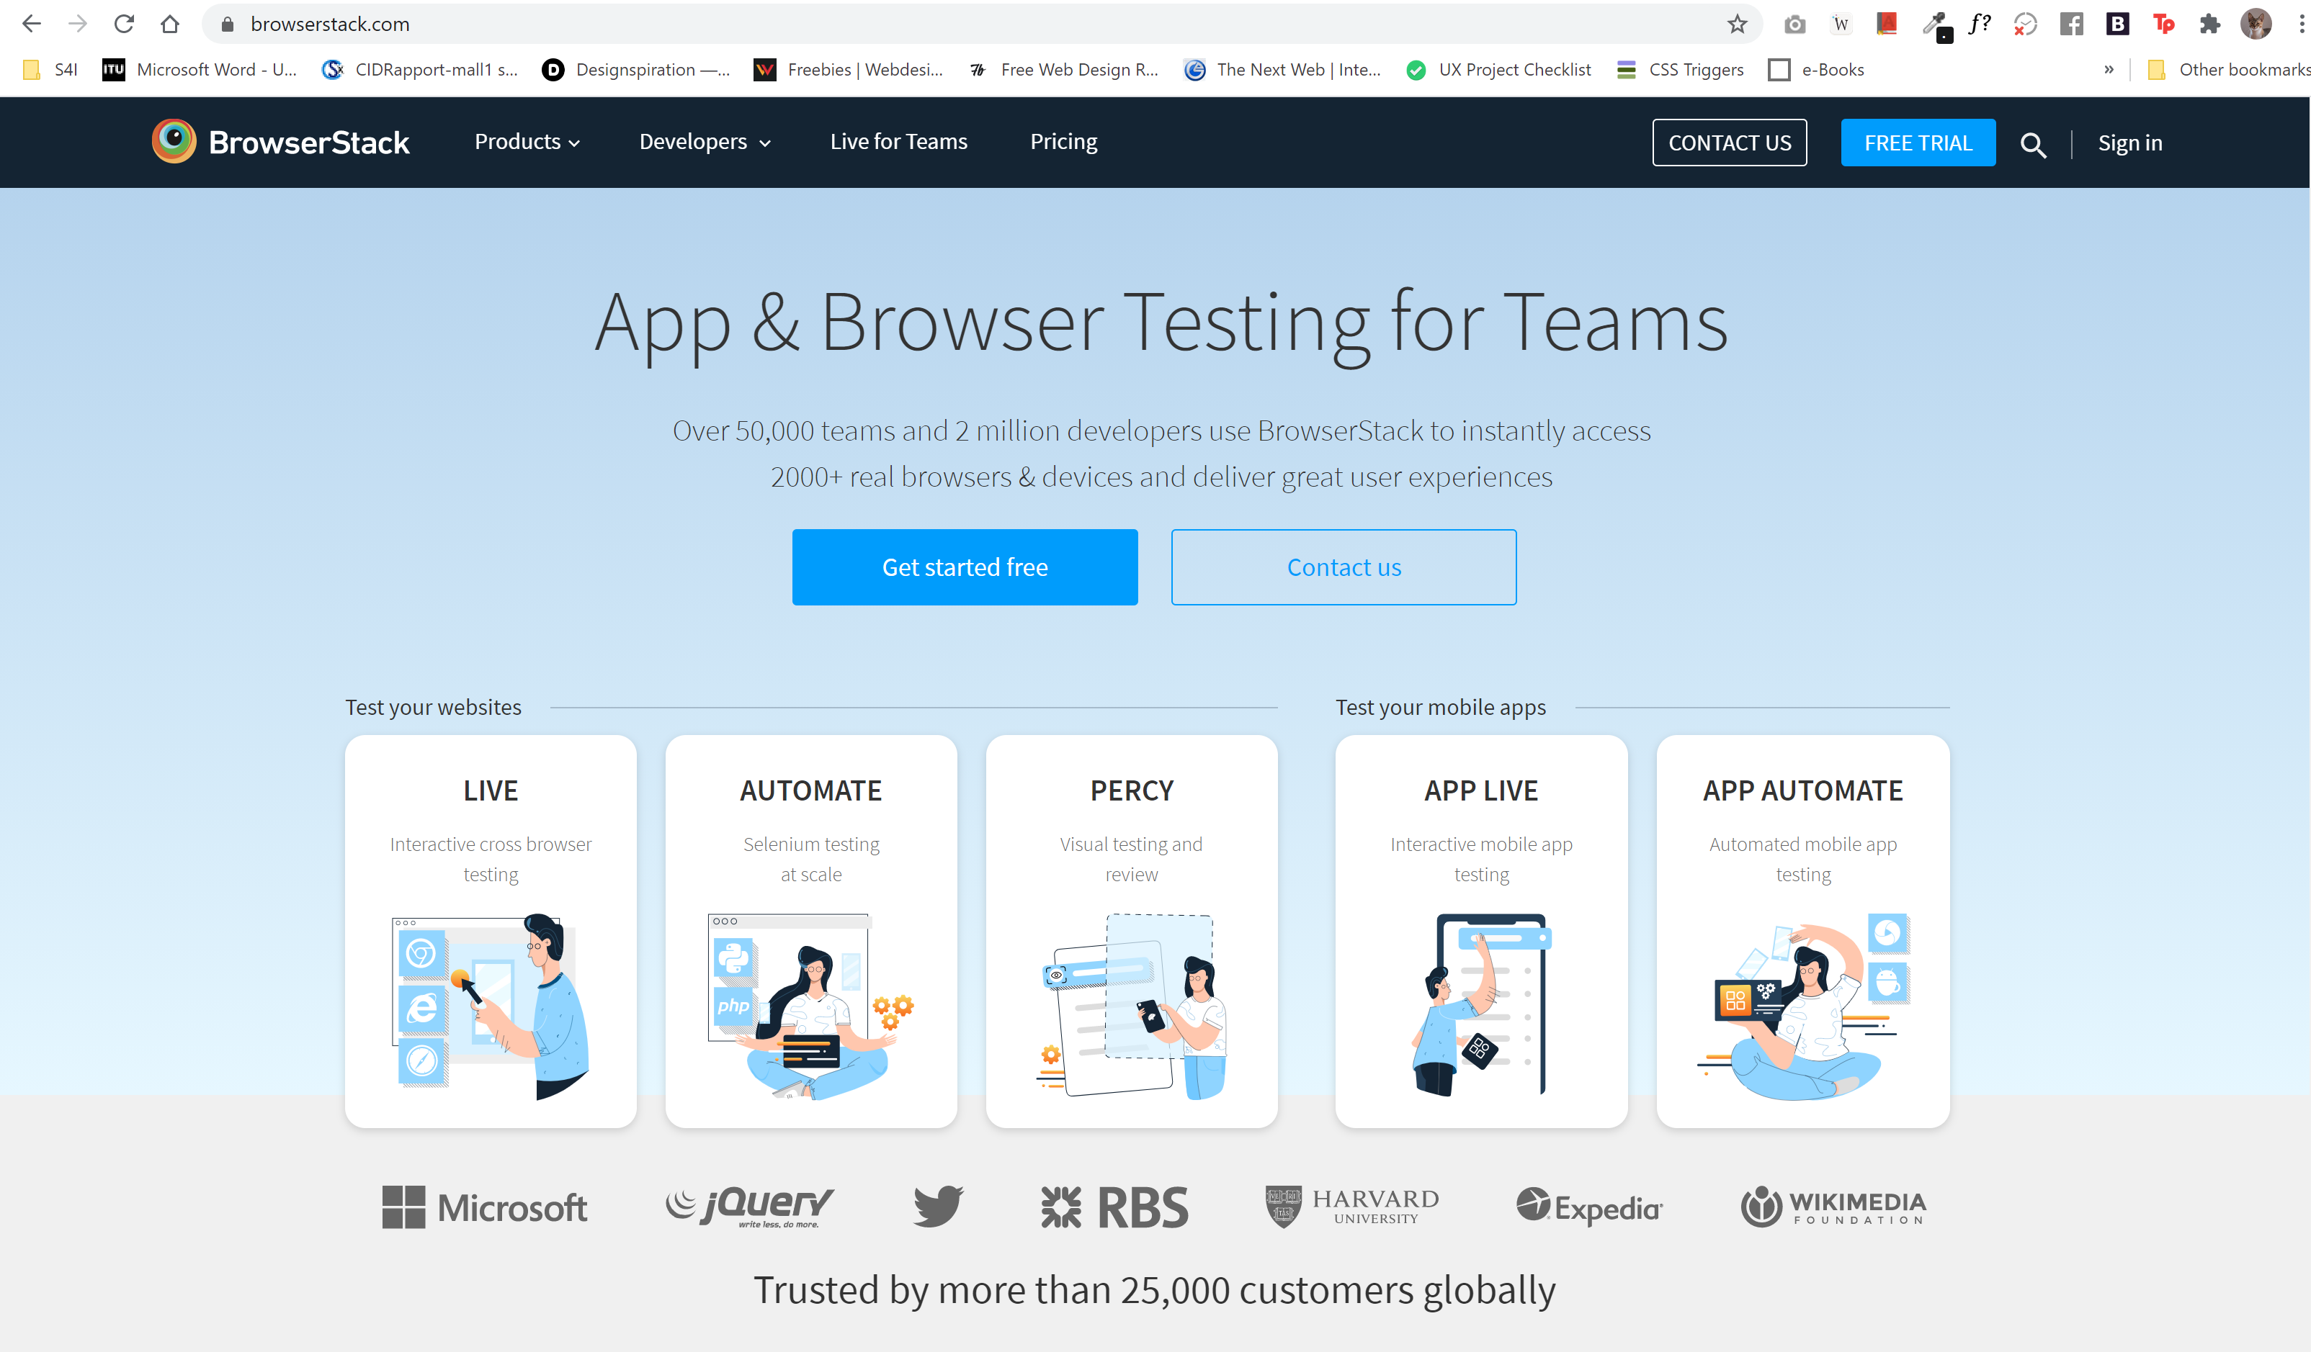

Step 1
Go to browserstack.com and login using your credentials (or the credentials you were provided with)

Slide 4
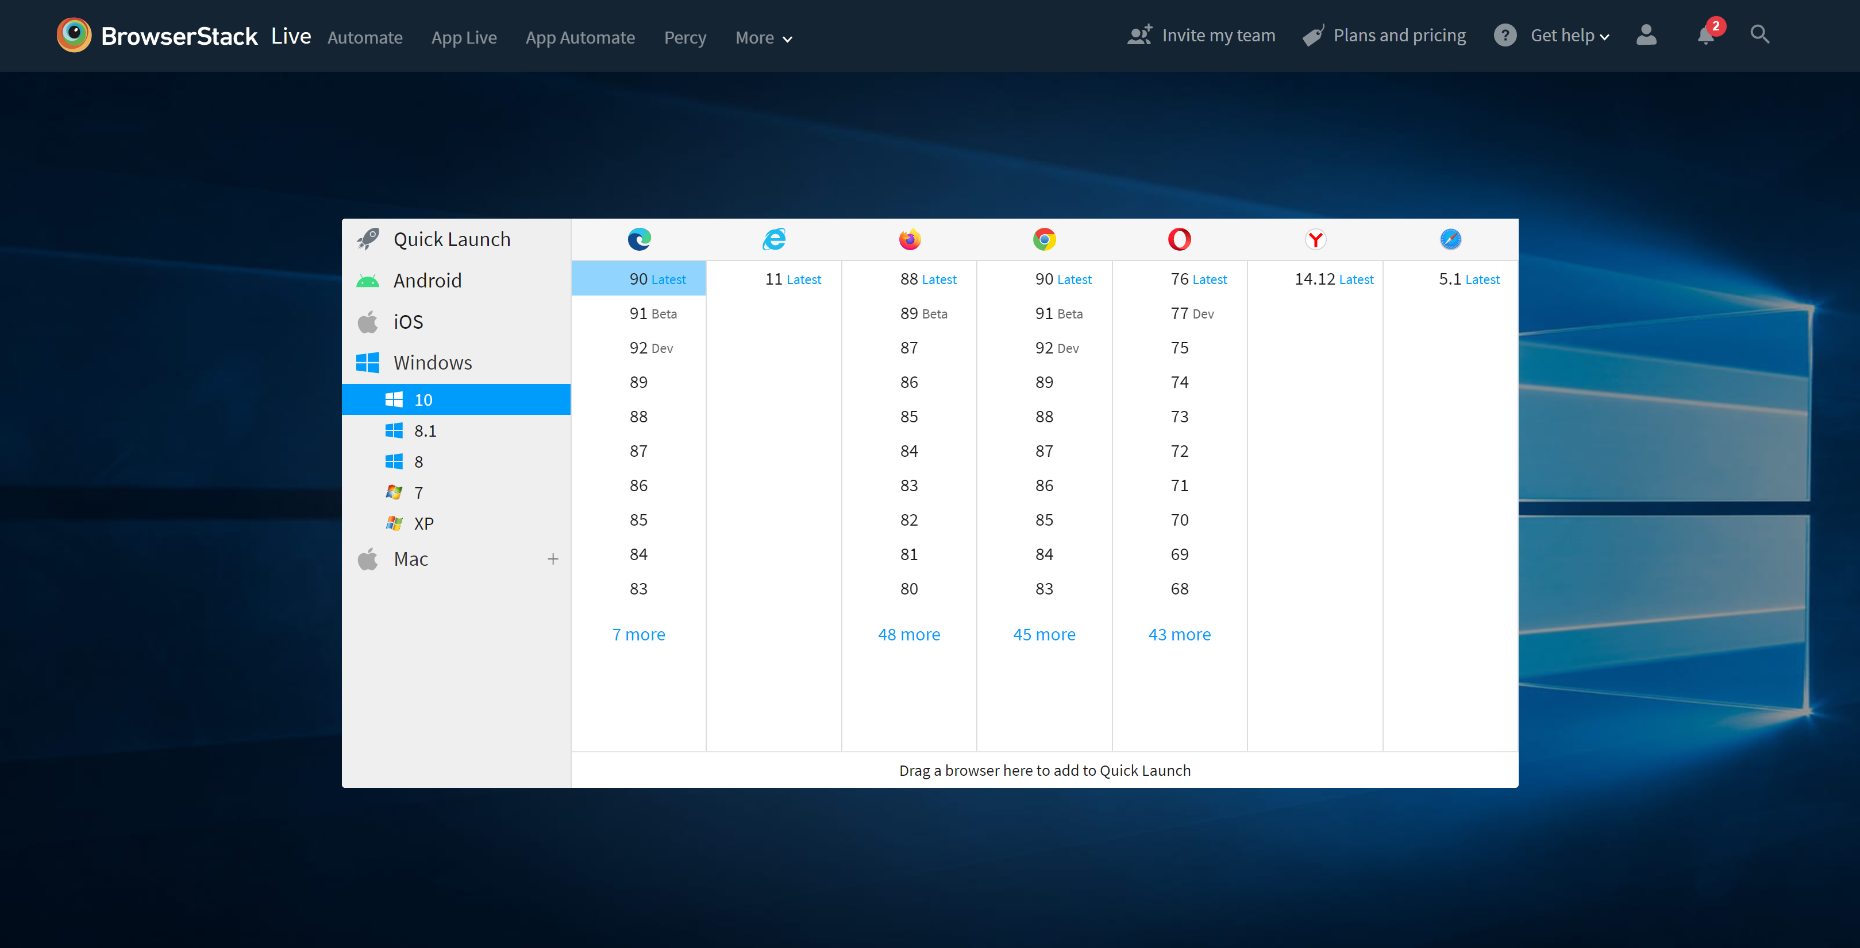
Once you're logged in, you will be presented with the options to launch a specific browser on specific operating system. For the purpose of this set up choose any combination and
launch it
Step 2
Click here to find out more about the OS-Browsers combinations​ we aim to test on. ​

Slide 5
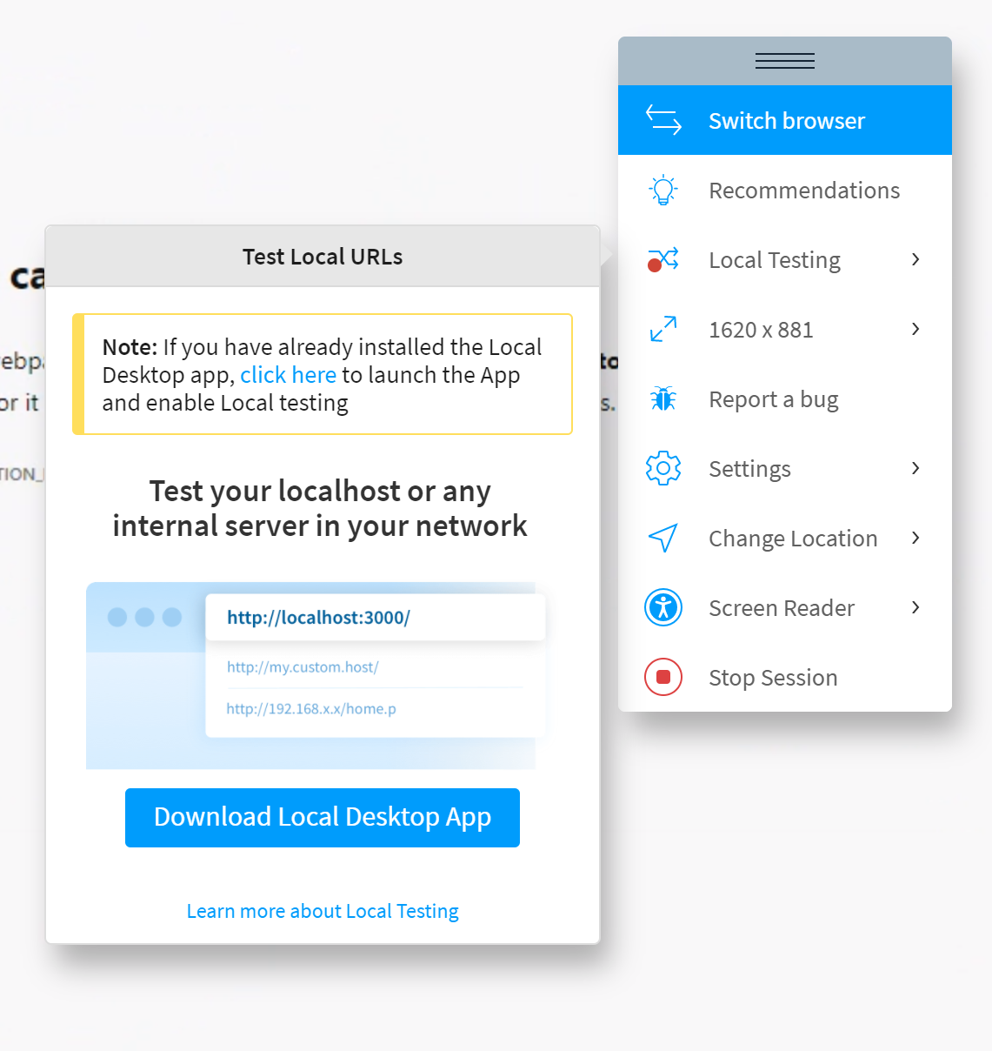
Step 3
Once you launch any browser, If you try to open any
private environments , you will see you won't be able to do so.
You need to enable Local Testing. You will see the following panel (see image)
Click on Local Testing
You need to download the Local
Desktop App to enable Local Testing Click on Download Local Desktop App

Slide 6
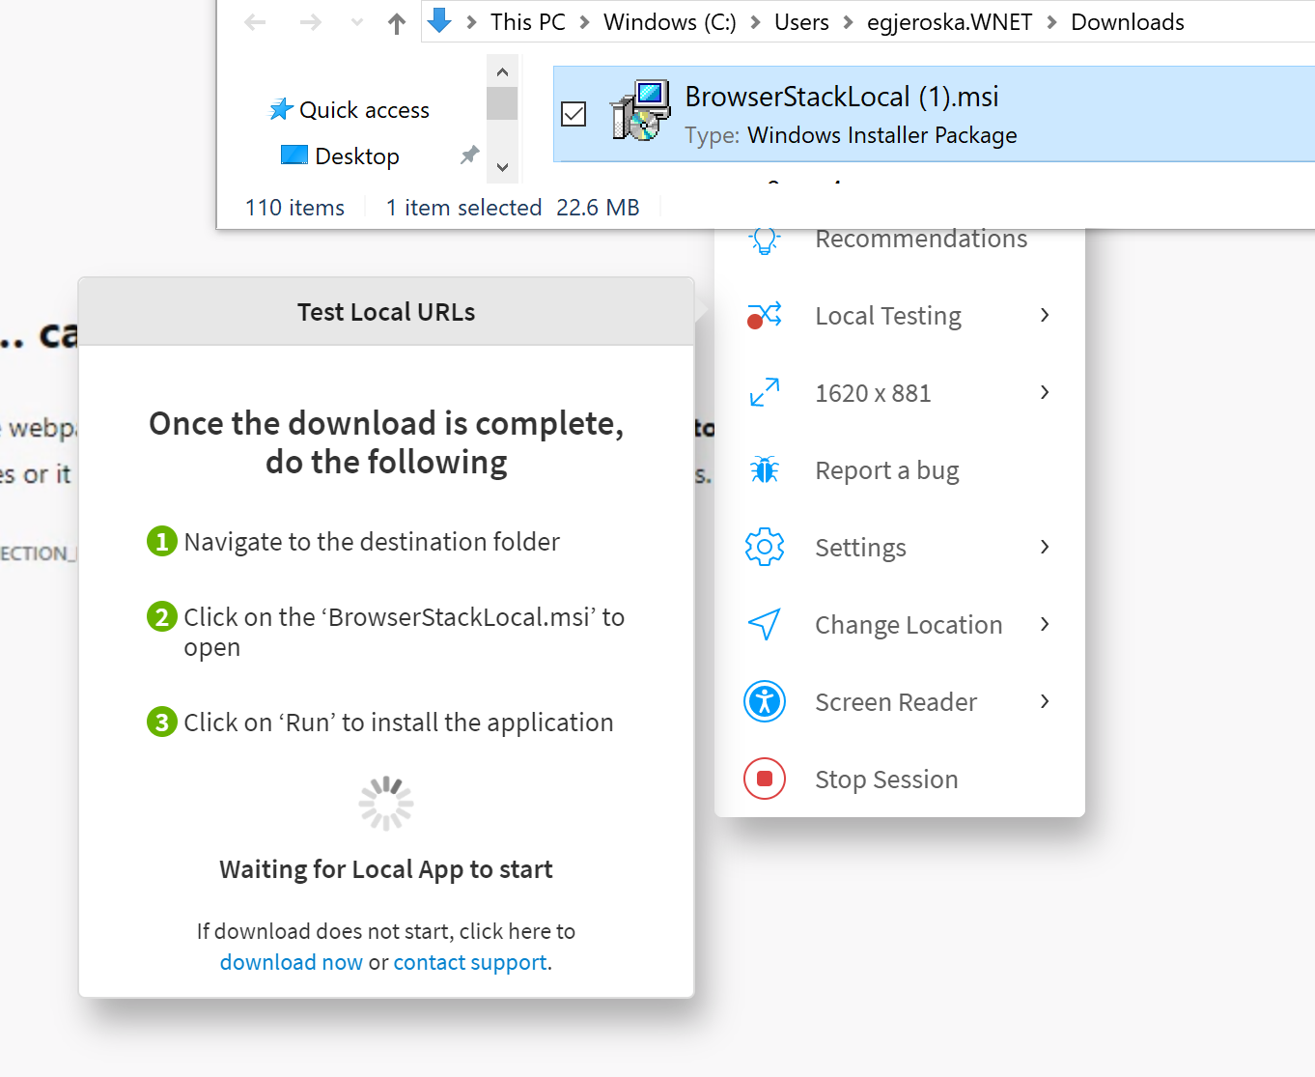
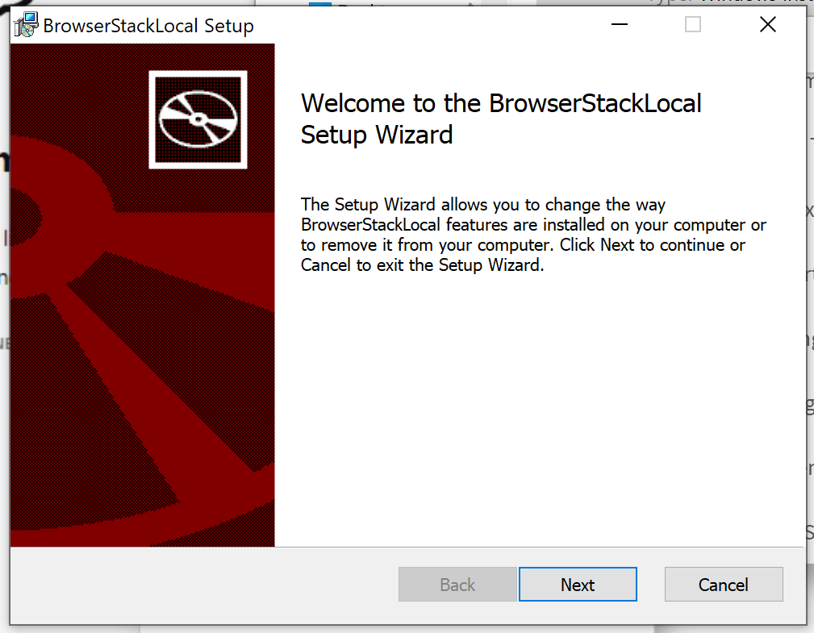
Step 4
Navigate to the destination folder
Click on BrowserStackLocal.msi
Install the app

Slide 7
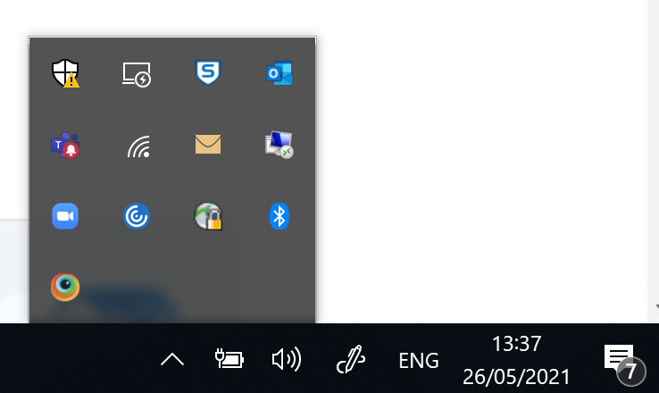


Step 5
Launch The Application
You should have the following
Setup (see image): The Browser Stack Icon is shown
(Desktop App is working ) You are connected to the VPN

Slide 8
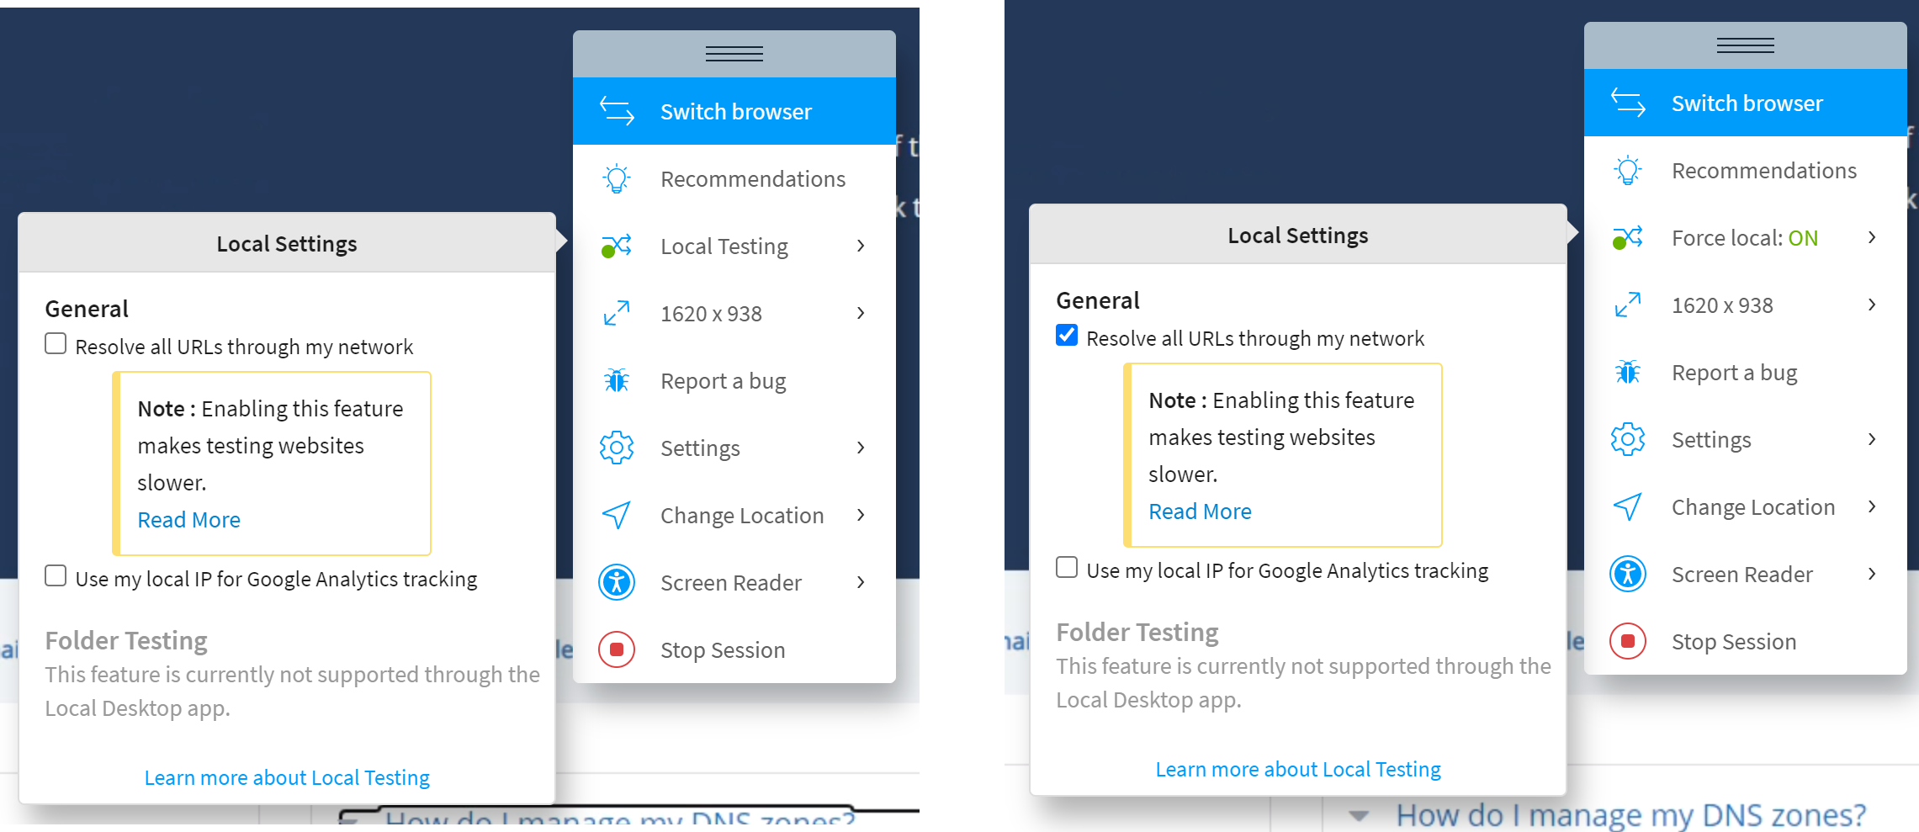
Step 6
Open Browser Stack again
Now, when you click on Local Testing, you will have a list of
available options (see image)
Check the first option: Resolve all URLs through my network
This setup will enable you to open any webpage in any Browser/Device using Browser Stack the same way as you would normally on your local machine

Slide 9
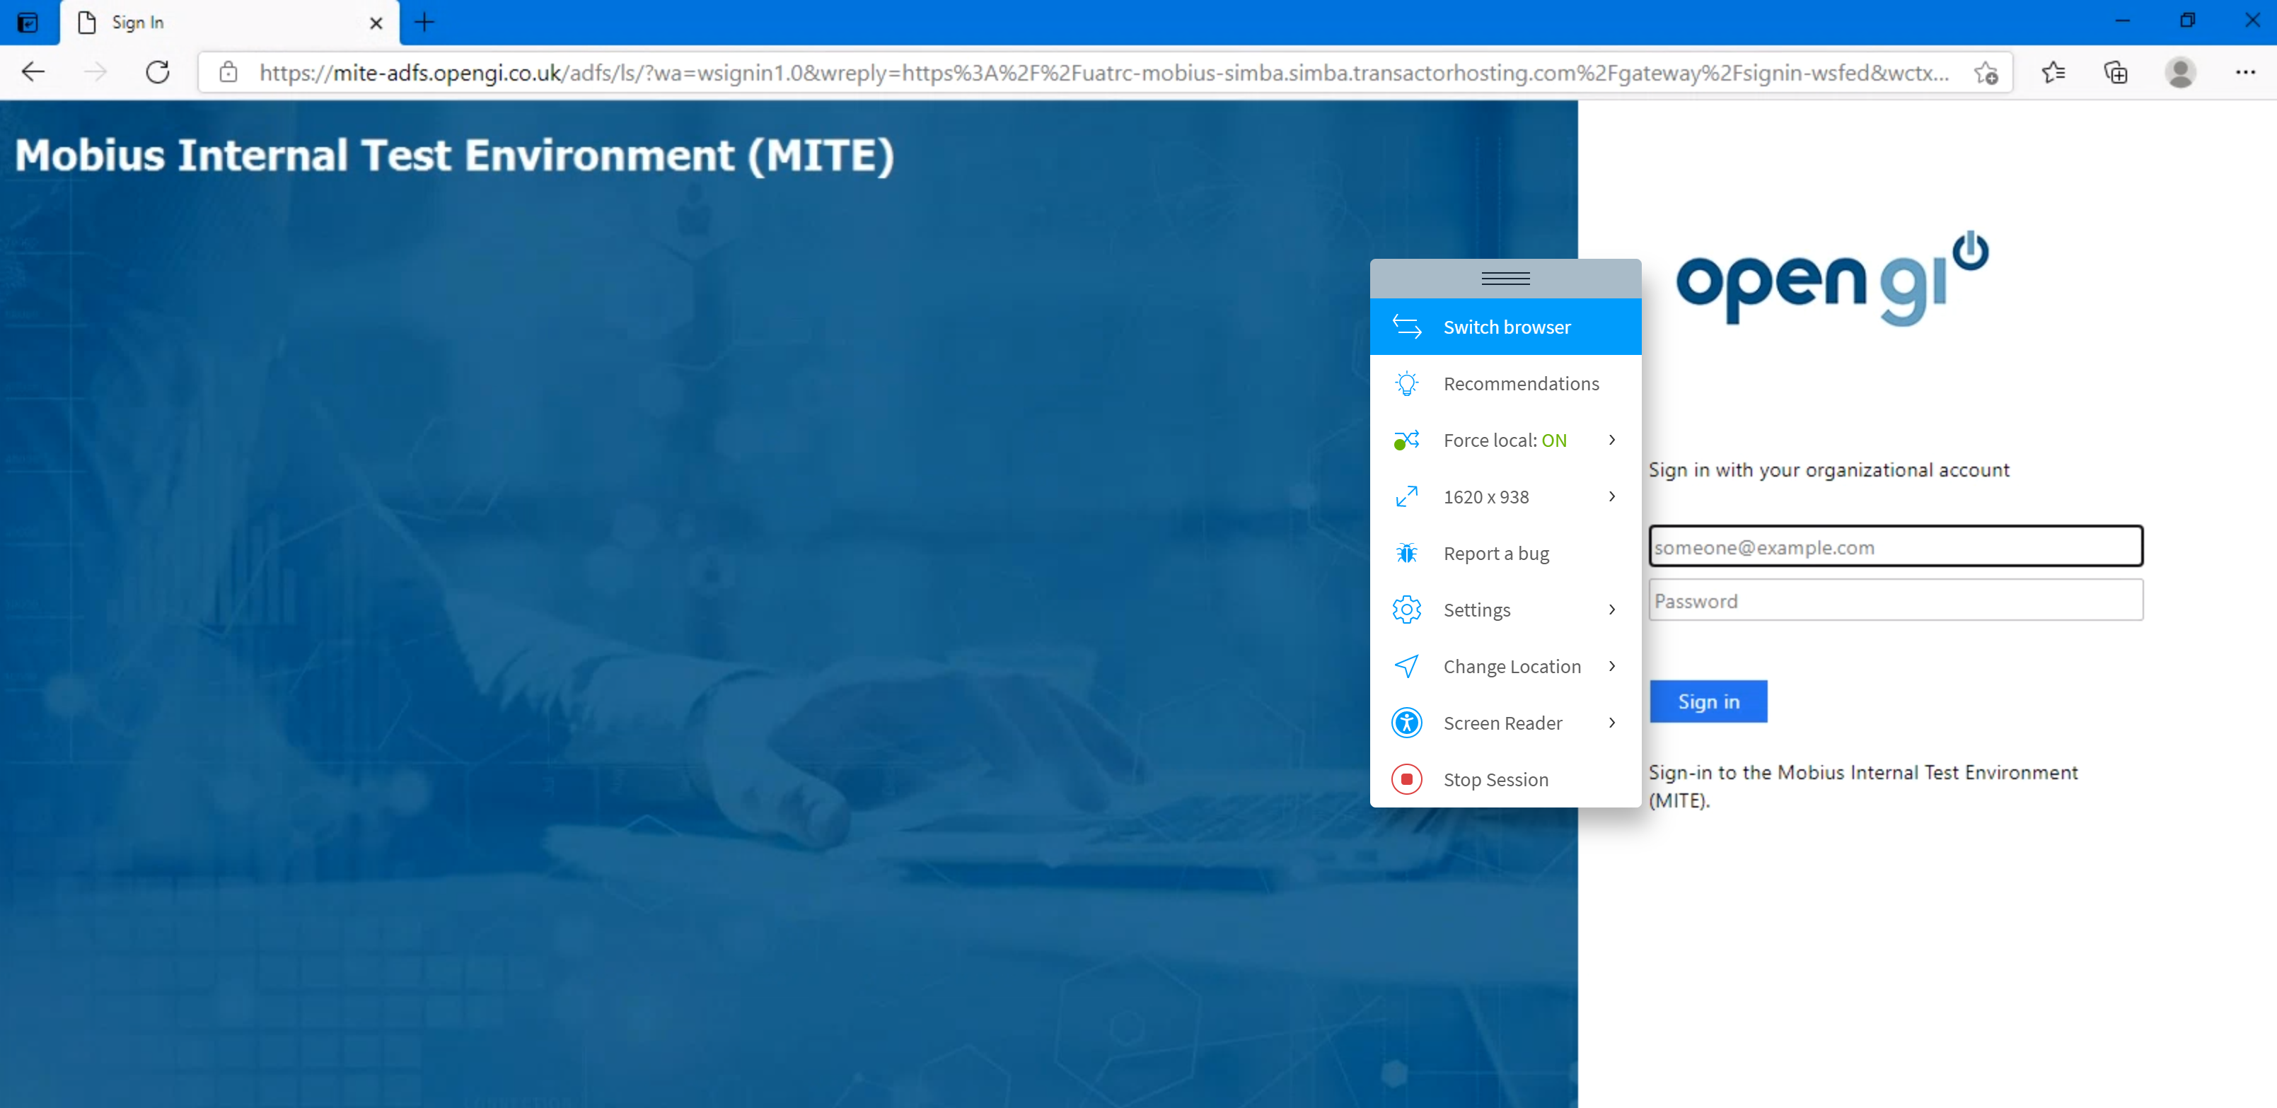
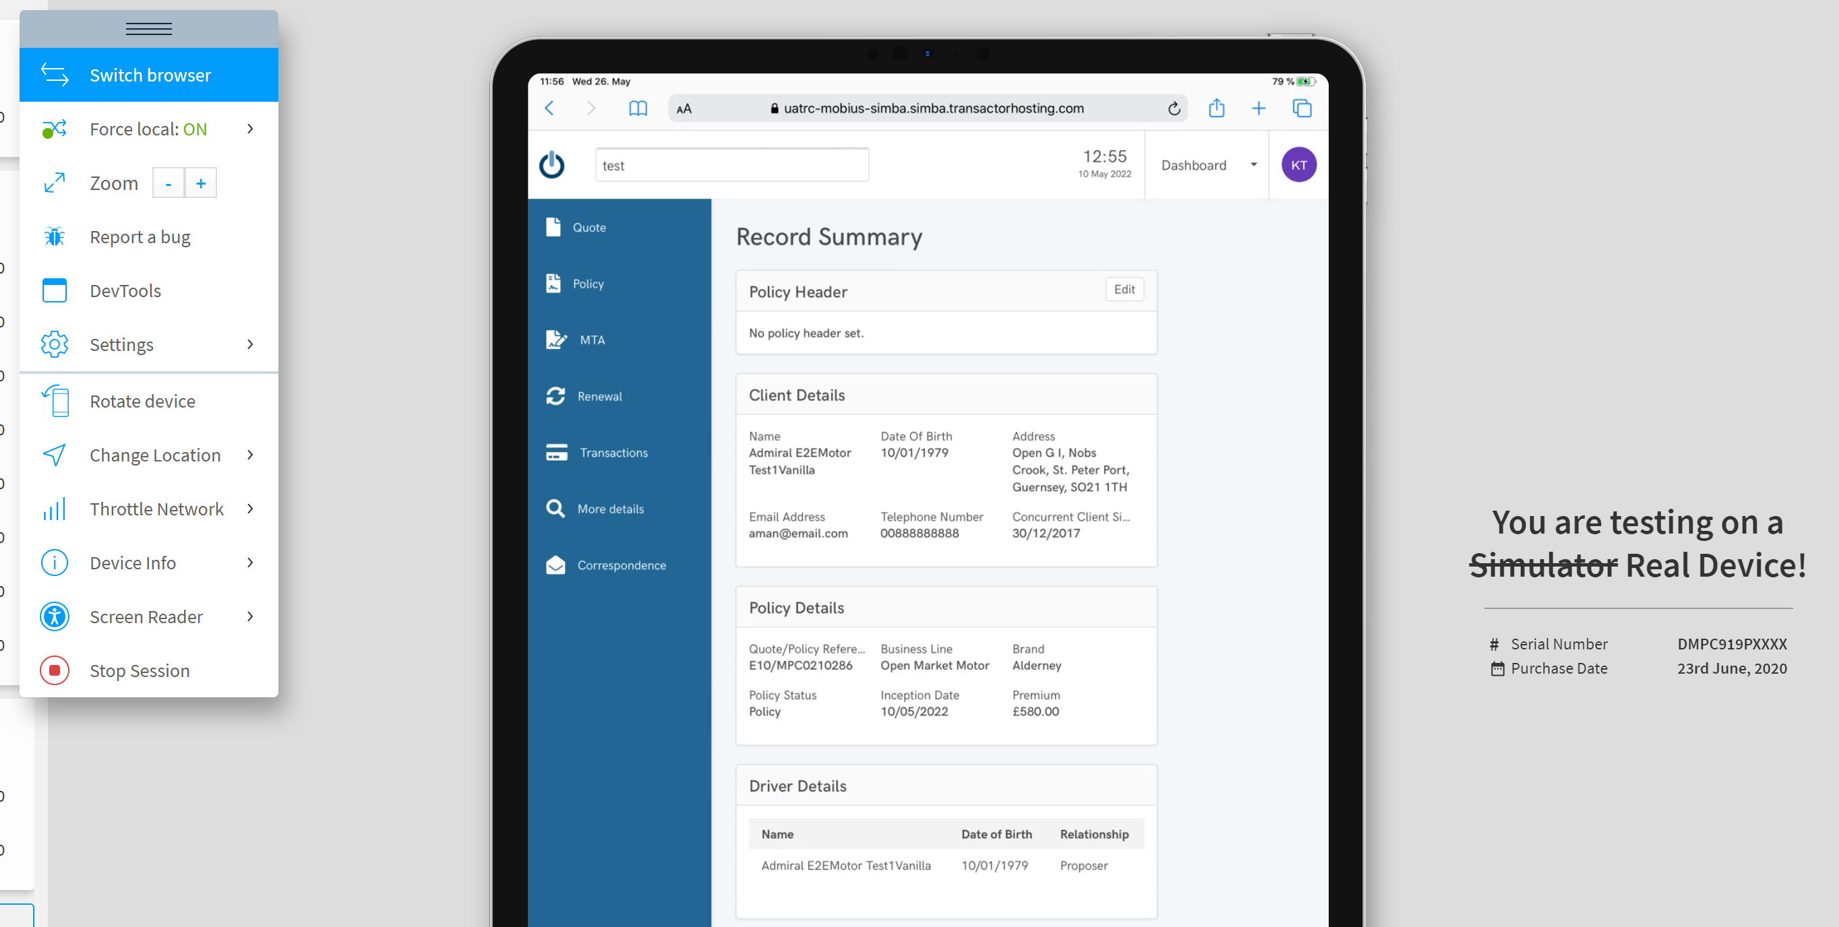
Go Bug Hunting 😊
Enjoy Browser Stack

Slide 10
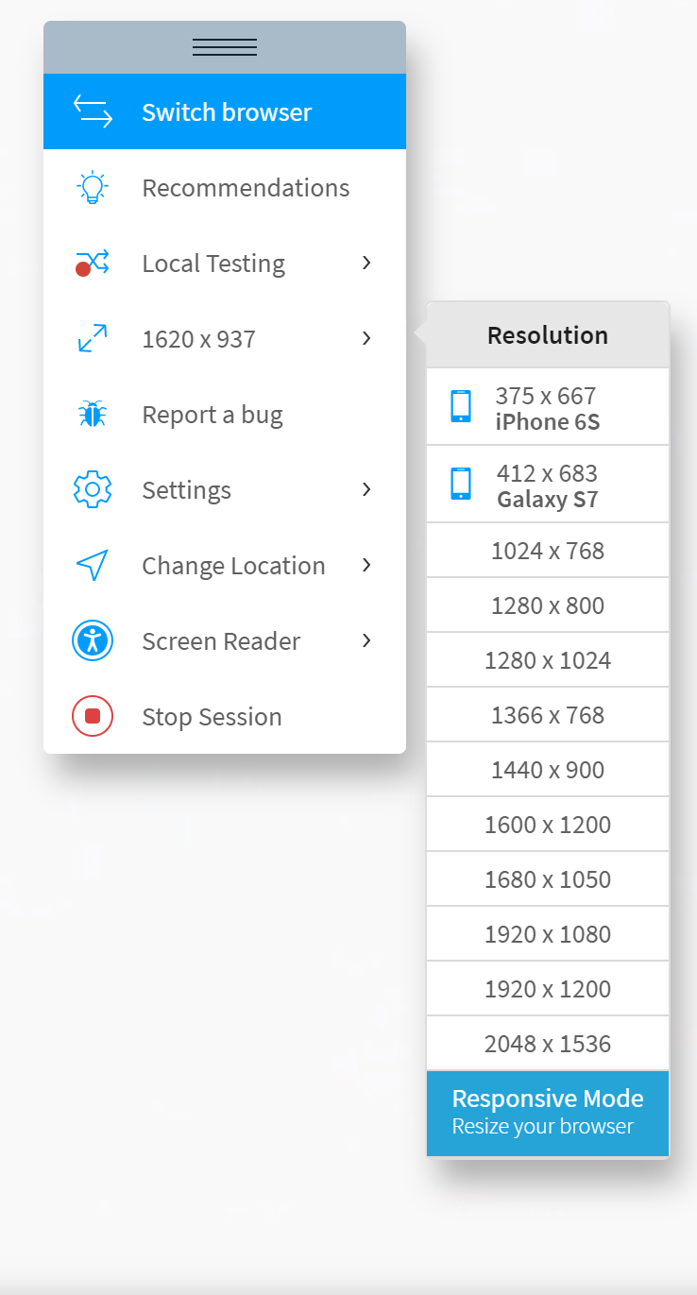
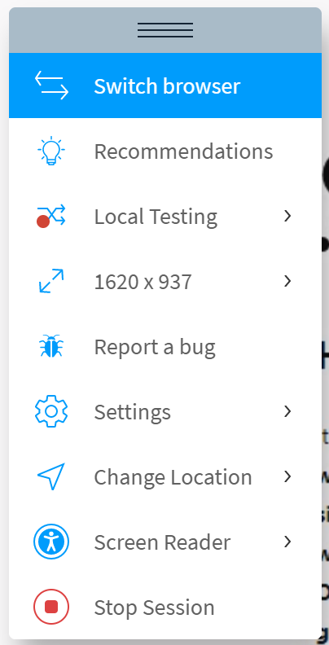
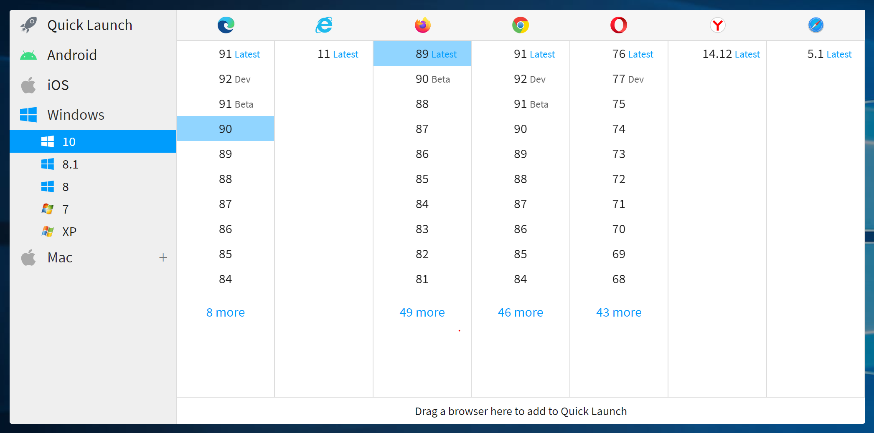
Browser Stack Options
1. Choose the operator system and browser combination
2. Set the right resolution
3.Make sure to stop
the session at the end
Not sure what combinations to test one? Click here to find out

Slide 11
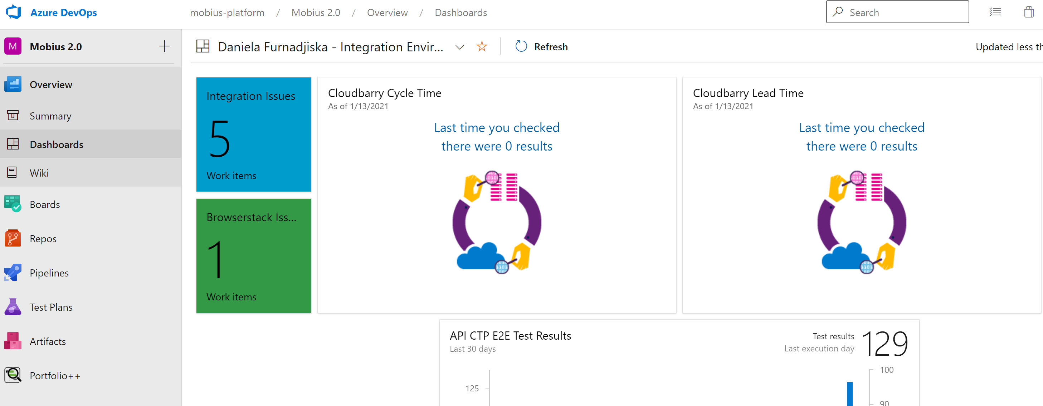

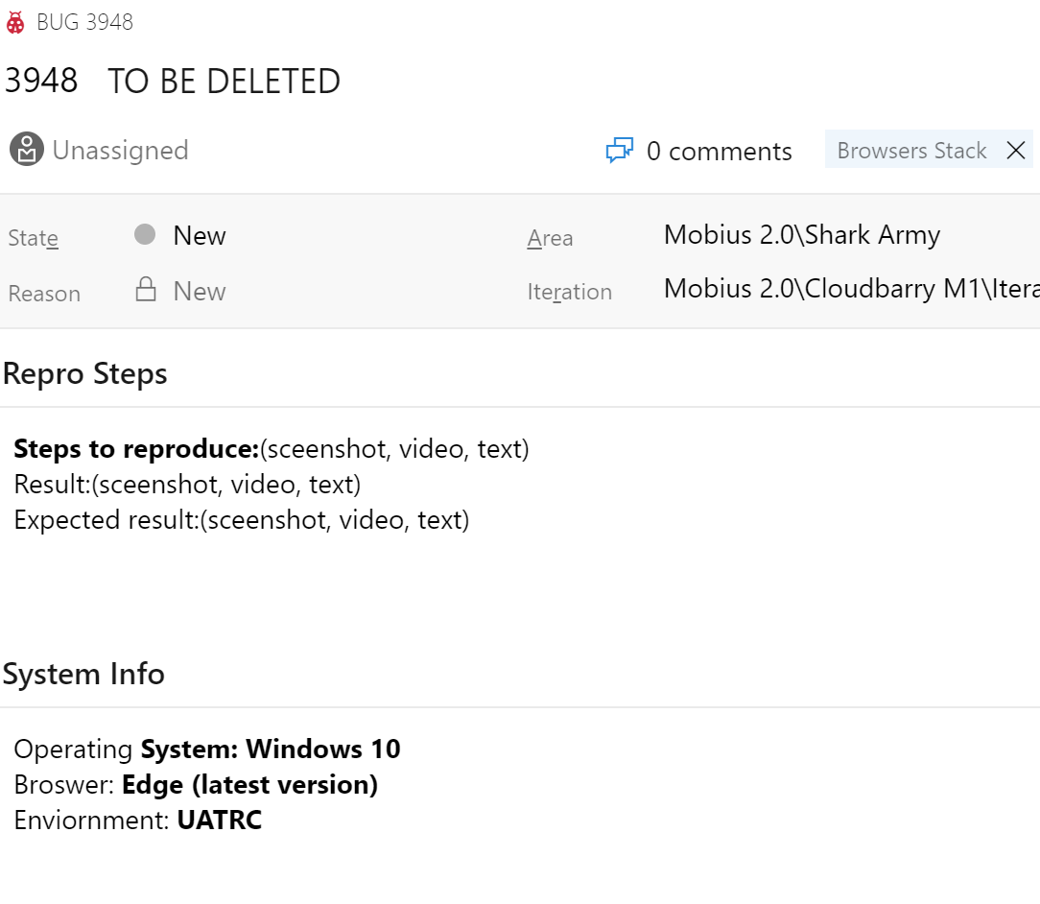
Report the bugs
You found a bug. What now?
Is it a visual bug that is related with the teams scope? Report it within your team . Is it a visual bug on platform level (affecting the whole app)? Report it to the programme team
How to report it? Before you open the bug in the backlog, go to the Dashboard and
check the list of Browser Stack Bugs to check if someone reported it already.
If it’s not there: -Open the bug -Make sure to mention the operating system , browser
(including version) combination, resolution (Desktop - 1920x1080, 1024x768) -Make sure to use the tag Browsers Stack

Slide 12
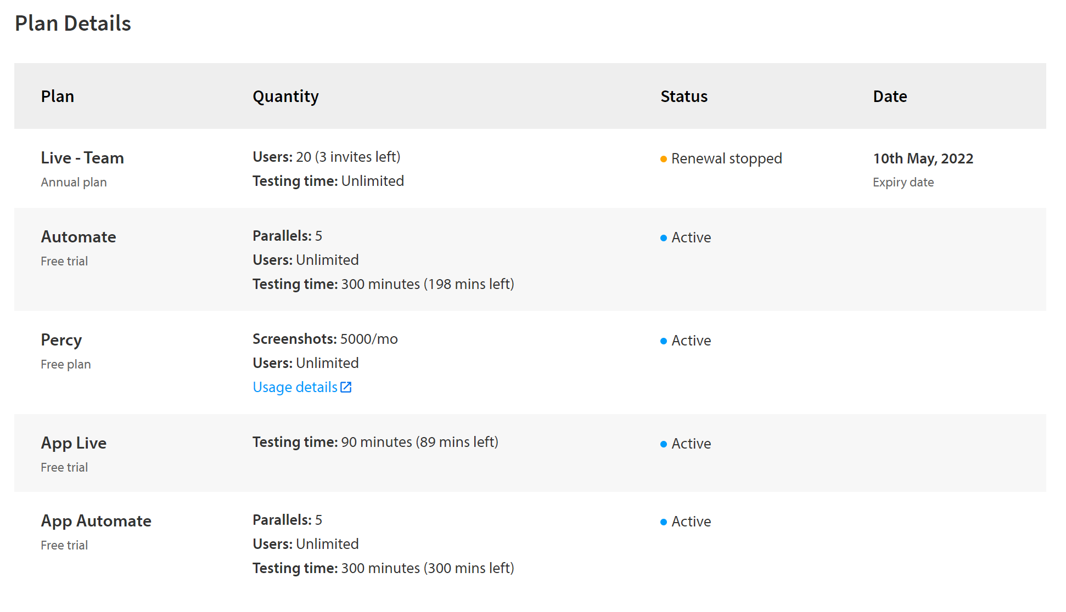
Further Steps Feel free to explore
Our plan includes partially
other options as well
Feel free to explore
The app beyond the visual
Testing.
If you find something
you particularly like or find
useful, let us know

Slide 13
Time for Questions, Opinions, Ideas, Feedback....
💯 Special Thanks to Rohan Kilje for the help and guidance
🤔 Do you have any additional questions?
Contact Daniela Furnadjiska or Elena Gjeroska

